Slide 1
Family Hubs End of Year Summary
2020/21

Slide 2
Children’s Centres
In line with government guidance, most face-to-face group work ceased and was replaced by a virtual timetable of activities, with sessions including Sign & Rhyme, targeted support, messy play, story times and African dance, targeting groups such as:
Brief Intervention Families
New Births
Children with SEND
Mothers with low mood/anxiety
Existing targeted families previously referred by social work/ health visitors
The Children’s Centres acted as a distribution/collection point for vitamins, the Food Banks and food vouchers and wellbeing/activity packs with over 2000 made and distributed to families including bespoke versions for parents and children with SEND.
Weekly calls to all families known to the service to proactively check on their welfare. A total of 5,648 calls were made.
Designated ‘safe spaces’ for partners and practitioners to deliver vital face to face appointments for vulnerable families. To date a total of 1262 bookings have been made.

Slide 3
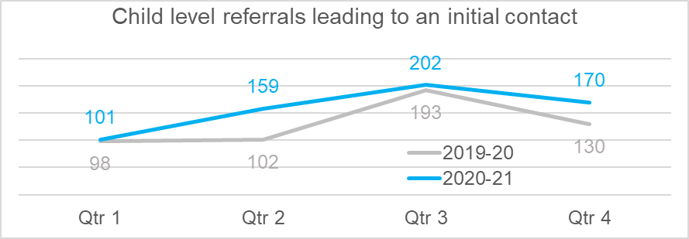
Family Hubs Casework
RAG rating system used. This system ensured that the most vulnerable families (ragged as red) were seen in-person in the Safe Spaces and outdoors and received weekly virtual contact. Families ragged amber and green were contacted virtually at least fortnightly.
Practitioners continued to support a full caseload as well as convene and facilitate Team around the Family (TAF) meetings with key professionals and families e.g. to attend school meetings and make specialist referrals to partner agencies where necessary.

Slide 4

School Attendance
A key priority for the Family’s Hubs has been to ensure children and young people were properly equipped to engage in online learning. During the first Lockdown, the Family Hubs arranged for 139 families to be provided with laptops or tablets and connectivity through the provision of dongles where necessary.
Regular meetings and conversations with schools were maintained to ensure children were logging on and being seen.
Our clinicians worked closely with practitioners, holding reflective team meetings and working with individual families to encourage and support children’s return to school.
When schools opened back on the 8th March 2021, 90% of those children open to the service, returned to school.

Slide 5
Wider Offer
Transition: Transition Programme for pupils identified as vulnerable in Year 6. During the summer of 2020 we delivered virtually to over 230 pupils across 7 primary schools, including two parent focused sessions
Young Carers: The Family Hubs have continued to maintain a focus on Young Carers and April 2020 saw the launch of the first virtual Young Carers Group for under 12’s activities have included quizzes, arts and crafts and cooking. A Young Carers group for children aged 12 & over has now been started. The focus for this group will be around practical matters such as GCSE options, budgeting, and taking care of their own health & well-being.
Parenting: Being aware of the changes in demand for parents and carers Family Hubs developed tip sheets to address the issues being raised. These were produced fortnightly and uploaded to the Family Information System (FIS). Virtual Coffee Mornings were held as an opportunity for parents to connect socially and reduce feelings of isolation.
BRSF: Supported by the Bi -borough coordinator we have supported many parents to attend the Tavistock’s online couple and group sessions on effective co-parenting for separated couples funded by the Department of Work and Pensions.
Families impacted by Grenfell Disaster: The North Family Hub team supported 48 families last year where they named the disaster as a factor contributing to their need for support. This was initially funded by the Grenfell Recovery fund but has now been absorbed as a core part of our business as usual in the Family Hubs.
Asylum seeking families in Earls Court: From late 2020 onwards over 500 people were placed in hotels by the Home Office. 93 were under 18 and some were unaccompanied minors. As part of the wider task group, Family Hubs staff have coordinated support for development checks, school admissions, immunisations and as well as setting up access to coats and vouchers for this very vulnerable group of children and their parents.

Slide 6
Next Steps…
Setting in place the requirements to implement the new Universal and Targeted pregnancy to five pathways and new integrated teams with health.
Further developing integrated leadership for the Family Hubs 0-19.
If successful in bids to MHCLG and DfE delivering the data accelerator and schools steppingstones programmes
Establishing the North Kensington Inclusion Team
Further rolling out the Trauma training and coaching including to the wider North Kensington community with joint funding from the CCG.
Re-opening and marketing the Children’s Centres and Youth Hubs for universal support and groups.
).

Slide 7
Thank you, now over to you for Q&A

